Slide 1

Database Systems and Web (15B11CI312)

Slide 2
Course Description
Modules | Title of the Module | Topics in the Module
1 | Introduction to Databases | Introduction to Databases, Physical Level of Data Storage, Structure of relational databases, Review of SQL Create, Insert, Update, Delete and Select Statements, Overview of NoSQL databases.
2 | Database Design and ER Model | Entity type, Attributes, Relation types, Notations, Constraints, Extended ER Features
3 | Relational Model and Structured Query Language | SQL: Data Definition and Data Manipulation, Relational Algebra
4 | Procedural Language | PL/SQL: Stored Procedures, Functions, Cursors, Triggers

Slide 3
Course Description (Contd..)
Modules | Title of the Module | Topics in the Module
5 | Normalisation | Data Dependencies, 2NF, 3NF, BCNF, building normalised databases
6 | Transaction Management | Transactions, Concurrency, Recovery, Security
7 | Web Architecture & Introduction | Motivation, characteristics and complexities of web applications, Basics, of Web Server and Application server, differences between web application and conventional software, architecture layers.
8 | Client Side Web Technology | SGML, HTML 5, DHTML, CSS, Java script
9 | Server Side Web Technology | PHP, Database Connectivity with PHP

Slide 4
Text books to be referred
1. | Henry F Korth, Abraham Silberschatz, S. Sudurshan, Database system concepts, 5th Edition, McGraw-Hill,2006
2. | Ramez Elmasri , Shamkant B. Navathe , Fundamentals of Database Systems, 4th Edition, Pearson Education, 2006.
3. | Ramakrishnan, Gehrke, Database Management Systems, Mcgraw-Hill, 3rd Edition, Addison-Wesley,2006.
4. | Thomas Connolly, Carolyn Begg, Database Systems-A Practical Approach to design, Implementation and Management, 3rd Edition, Addison-Wesley,2002.

Slide 5
Text books to be referred
5. | “PHP and MYSQL Manual” by Simon Stobart and Mike Vassileiou
6. | “PHP and MYSQL Web Development” by Luke Welling and Laura Thomson(Pearson Education)
7. | “An introduction to database systems” by Bipin C. Desai, West Publishing Company, College & School Division, 1990 - Computers - 820 pages
8. | Christopher J. Date, Database Design and Relational Theory: Normal Forms and All That Jazz, 2012.
9. | Rajiv Chopra, Database Management System (DBMS): A Practical Approach, 5th Edition, 2016, 682 pages.

Slide 6
Online resource to be referred
Nptel course
DATA BASE MANAGEMENT SYSTEM,
Video Lectures by –
PROF. SAMIRAN CHATTOPADHYAY
PROF. PARTHA PRATIM DAS
Department of Computer Science and Engineering
IIT Kharagpur
available at : https://nptel.ac.in/courses/106/105/106105175/

Slide 7
Course objectives
COURSE OUTCOMES |  | COGNITIVE LEVELS
C212.1 | Explain the basic concepts of Database systems and Web components. | Understand Level (Level II)
C212.2 | Model the real world systems using Entity Relationship Diagrams and convert the ER model into a relational logical schema using various mapping algorithms | Apply Level (Level III)
C212.3 | Develop a simple web application with client and server side scripting using Javascript and PHP and connect with a given relational database | Create Level (Level VI)
C212.4 | Make use of SQL commands and relational algebraic expressions for query processing. | Apply Level (Level III)
C212.5 | Simplify databases using normalization process based on identified keys and functional dependencies | Analyse Level (Level IV)
C212.6 | Solve the atomicity, consistency, isolation, durability, transaction, and concurrency related issues of databases | Apply Level (Level III)

Slide 8
Assessment tools/Evaluation Criteria
Components Maximum Marks
T1 20
T2 20
End Semester Examination 35
TA 15
Attendance 10
Total 100

Slide 9
Database Systems and Web
Lecture 1

Slide 10
Contents to be covered
Data vs. Information
Introduction to DATABASE and Database Management Systems
Applications of a DBMS
Extending database capabilities for new applications
Drawbacks of old file methods
The advantages of DBMS
DBMS environment

Slide 11
“You can have data without information, but you cannot have information without data”
- DANIEL KEYS MORAN

Slide 12
Data Vs. Information
Data can be thought of as a description of the World.
Data is a collection of facts about an entity such as values or measurements.
It can be numbers, words, measurements, observations or even just descriptions of things.
For example : Text data (your age , phone number , cgpa etc)
Audio data (recorded songs in your mobile)
Video data (video recording of your online lectures)
Image data (your family photo)
Map data (City map of your city)

Slide 13
Data Vs. Information
Information is processed , organized, useful and meaningful data.
For example
“6 feet” is a data whereas John’s height is “6 feet” is information.
Data is converted into information, and information is converted into knowledge.
Knowledge: information evaluated and organized so that it can be used purposefully.

Slide 14
DATABASE
Collection of related pieces of data.
Representing/capturing the information about a real-world enterprise or part of an enterprise.
A database is designed ,built ,populated with data for a specific purpose.
It has intended group of users and preconceived application.
Activities of the enterprise are supported by the database and continually update the database.

Slide 15
DATABASE
Example1: University Database
Data about students, faculty, courses, laboratories, course registration/enrollment etc.
Purpose: To keep an accurate track of the academic activities of the university.
Example2: Railways Database
Data about trains, available or reserved seats, train routes , train number etc.
Purpose: To keep an accurate information of the trains
More Example : Airline, Grocery shop, database of satellite images etc

Slide 16
Database Management System(DBMS)
A software package or set of computer programs designed to store and manage databases.
DBMS tasks
Managing large quantity of structured data .
Efficient retrieval and modification using query processing and optimization
Sharing data: multiple users use and manipulate data .
Controlling the access to data: maintaining the data integrity.

Slide 17
Applications of a DBMS
Banking
Airlines
Universities
Telecommunication
Finance
Sales
Manufacturing
HR Management
Many more…….
Reading Suggestion: Silberschatz,Korth and Sudarshan , ”Database System Concepts”, Chapter 1

Slide 18
Extending Database Capabilities for New Applications
Scientific applications
Example : use human genome or medical Database, AI based application used large database
Storage and retrieval of images
Storage and retrieval of videos,
Data mining and data analytics applications
Spatial applications
Time series applications
Reading Suggestion: Elmasri and Navathe , ” FUNDAMENTALS OF DATABASE SYSTEMS”, Chapter 1

Slide 19
Drawbacks of old file methods
Inconsistent data
Limited data sharing
Data Integrity Problems
Concurrent-access anomalies
Security issues
Uncontrolled Duplication: Data redundancy
Wastes space
Hard to update all files
Inflexibility
Hard to change data
Hard to change programs
Reading Suggestion: Silberschatz,Korth and Sudarshan , ”Database System Concepts”, Chapter 1

Slide 20
The Advantages of DBMS
Minimal data redundancy.
Data consistency.
Integration of data.
Sharing of data.
Enforcement of standards.
Uniform security, privacy and integrity.
Data independence
Ease of application development.
Reading Suggestion: Silberschatz,Korth and Sudarshan , ”Database System Concepts”, Chapter 1

Slide 21
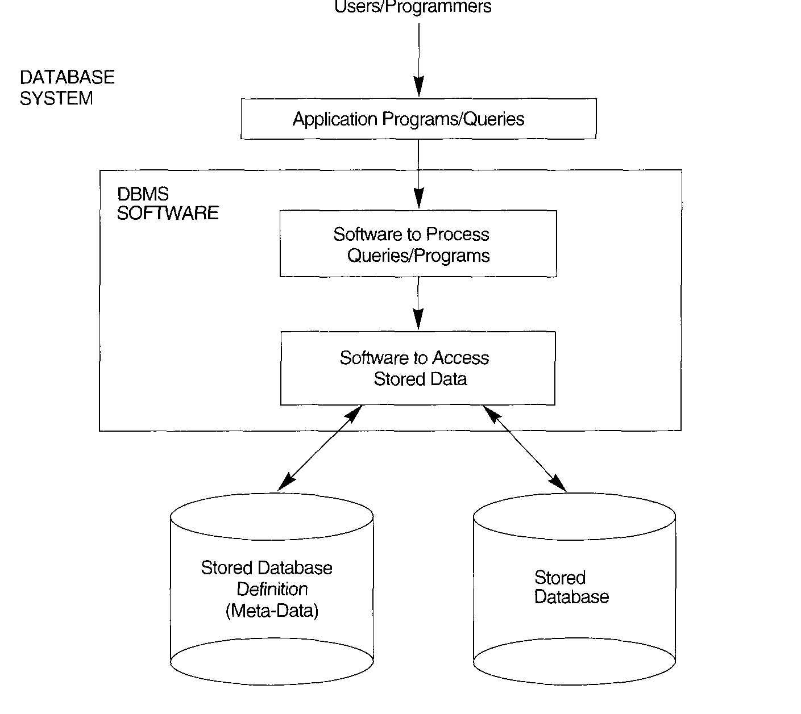
DBMS Environment
Reading Suggestion and image source: Elmasri and Navathe , ” FUNDAMENTALS OF DATABASE SYSTEMS”, Chapter 1

Slide 22
Example of DBMS
Commercial | Open Source
Oracle | MySQL
Microsoft SQL Server | PostgreSQL
IBM Db2 | MongoDB
Microsoft Access | Redis
Splunk | Elasticsearch

Slide 23
General Discussion
When to use a DBMS?
&
When not to use a DBMS?
&
Can we use partial services of DBMS?

